Slide 1
Family

Slide 2
Wife and
husband

Slide 3
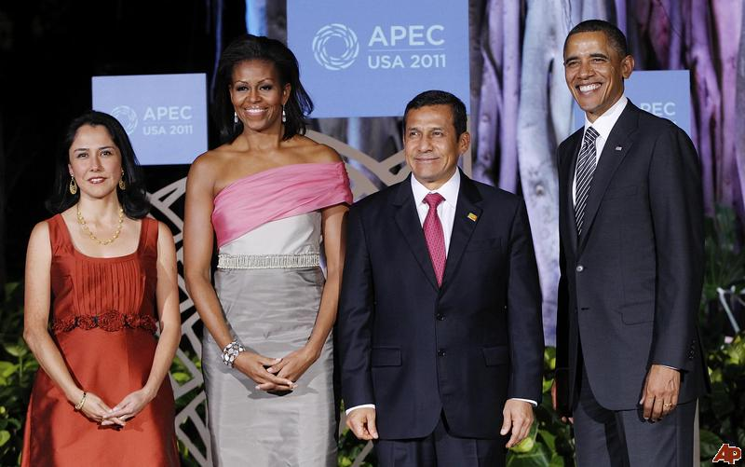
Obama (husband) and his wife
Nadine (wife) and her husband

Slide 4
Mother

Slide 5
Father

Slide 6
Daughter

Slide 7
Son

Slide 8
Brothers

Slide 9
Sisters

Slide 10
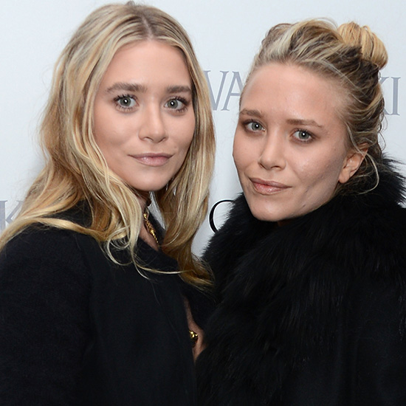
Sisters

Slide 11
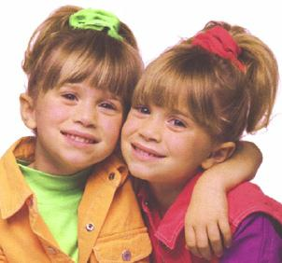
Sisters

Slide 12
Brother and Sister

Slide 13
Mother and
Father

Slide 14
Grandmother

Slide 15
Grandfather

Slide 16
Grandfather and grandmother

Slide 17
Father and Daughter

Slide 18
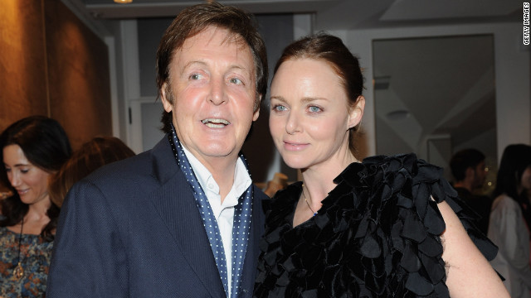
Paul McCartney and Daughter

Slide 19
Mother and son

Slide 20
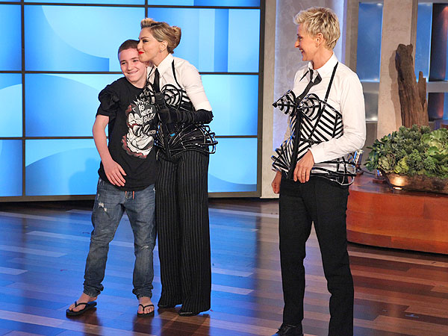
Madonna and her son.

Slide 21
Mother and Daughter

Slide 22
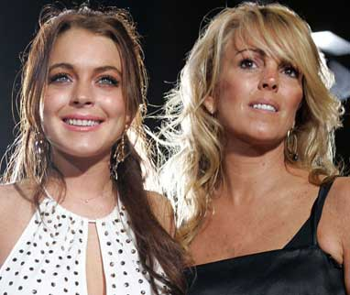
Mother and Daughter

Slide 23
Father and Son

Slide 24
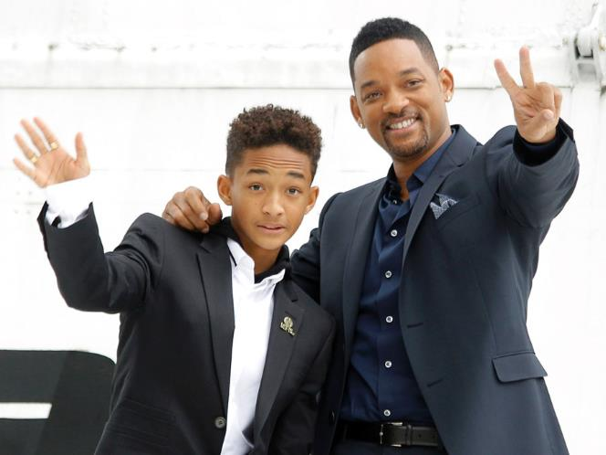
Father and Son

Slide 25
Answer these questions with your partner
Do you have a large or small family?
a) I have a small family. In my family there are 4 people, my father…
b) I have a large family. In my family there are 12 people, my father…
In your family, who are you close to?
In my family, I am close to my sister. I talk to her and she is my friend.

